Slide 1
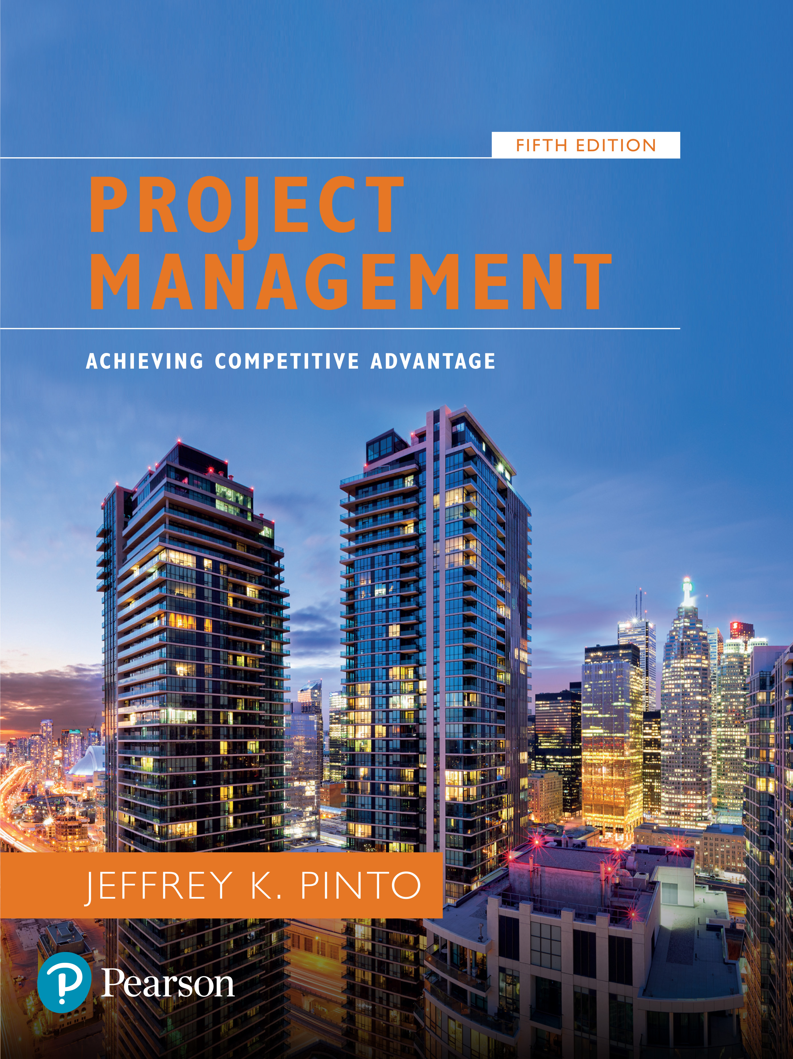
Project Management: Achieving Competitive Advantage
Fifth Edition
Chapter 3
Project Selection and Portfolio Management
Copyright © 2019, 2016, 2013 Pearson Education, Inc. All Rights Reserved
Notes:
If this PowerPoint presentation contains mathematical equations, you may need to check that your computer has the following installed:
1) MathType Plugin
2) Math Player (free versions available)
3) NVDA Reader (free versions available)

Slide 2
Learning Objectives
3.1 Explain six criteria for a useful project selection/screening model.
3.2 Understand how to employ a variety of screening and selection models to select projects.
3.3 Learn how to use financial concepts, such as the efficient frontier and risk/return models.
3.4 Identify the elements in the project portfolio selection process and discuss how they work in a logical sequence to maximize a portfolio.

Slide 3
P M B O K Core Concepts
Project Management Body of Knowledge (P M B o K) covered in this chapter includes:
Portfolio Management (P M B o K 1.4.2)

Slide 4
Project Selection
Screening models help managers pick winners from a pool of projects. Screening models are numeric or nonnumeric and should have:
Realism
Capability
Flexibility
Ease of use
Cost effectiveness
Comparability

Slide 5
Screening and Selection Issues (1 of 2)
Risk—unpredictability to the firm
a. Technical
b. Financial
c. Safety
d. Quality
e. Legal exposure
Commercial—market potential
a. Expected return on investment
b. Payback period
c. Potential market share
d. Long-term market dominance
e. Initial cash outlay
f. Ability to generate future business/new markets

Slide 6
Screening and Selection Issues (2 of 2)
Internal operating—changes in firm operations
a. Need to develop/train employees
b. Change in workforce size or composition
c. Change in physical environment
d. Change in manufacturing or service operations
Additional
a. Patent protection
b. Impact on company’s image
c. Strategic fit
All models only partially reflect reality and have both objective and subjective factors imbedded.

Slide 7
Approaches to Project Screening
Checklist model
Simplified scoring models
Analytic hierarchy process
Profile models

Slide 8
Checklist Model
A checklist is a list of criteria applied to possible projects.
Requires agreement on criteria
Assumes all criteria are equally important
Checklists are valuable for recording opinions and stimulating discussion.

Slide 9
Simplified Scoring Models
Each project receives a score that is the weighted sum of its grade on a list of criteria.
Scoring models require:
agreement on criteria
agreement on weights for criteria
a score assigned for each criteria
Relative scores can be misleading!

Slide 10
Analytic Hierarchy Process
The A H P is a four step process:
Construct a hierarchy of criteria and subcriteria.
​Allocate weights to criteria.
Assign numerical values to evaluation dimensions.
​Determine scores by summing the products of numeric evaluations and weights.
Unlike the simple scoring model, these scores can be compared!

Slide 11
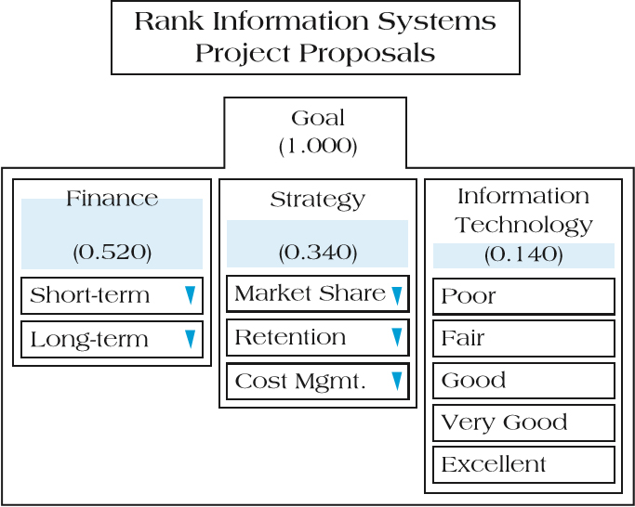
Figure 3.1 Sample A H P with Rankings for Salient Selection Criteria

Slide 12
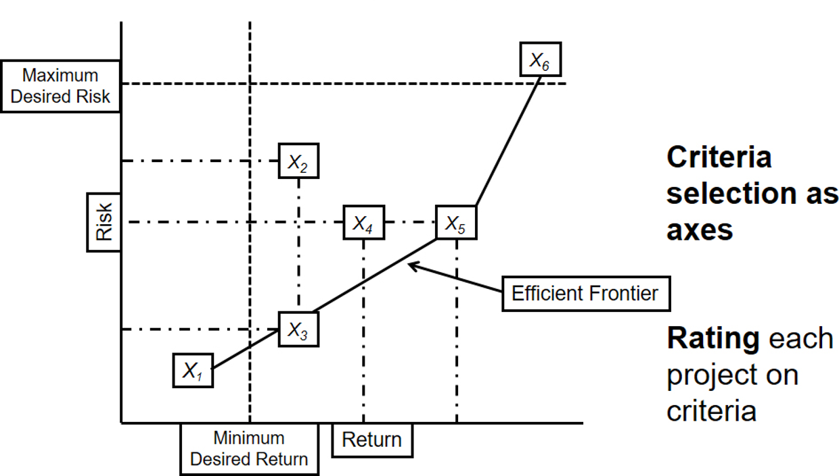
Figure 3.4 Profile Model

Slide 13
Financial Models
Payback period
Net present value
Discounted payback period
Internal rate of return

Slide 14
Payback Period
Determines how long it takes for a project to reach a breakeven point.
Cash flows should be discounted.
Lower numbers are better (faster payback).

Slide 15
Payback Period Example (1 of 3)
Table 3.5 Initial Outlay and Projected Revenues for Two Project Options
Blank | Project A Revenues | Project A Outlays | Project B Revenues | Project B Outlays
Year 0 | Blank | $500,000 | Blank | $500,000
Year 1 | $50,000 | Blank | $75,000 | Blank
Year 2 | 150,000 | Blank | 100,000 | Blank
Year 3 | 350,000 | Blank | 150,000 | Blank
Year 4 | 600,000 | Blank | 150,000 | Blank
Year 5 | 500,000 | Blank | 900,000 | Blank

Slide 16
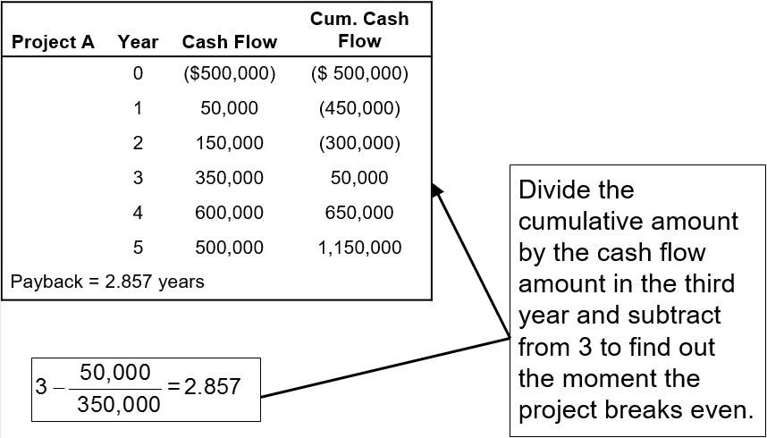
Payback Period Example (2 of 3)
Table 3.6 Comparison of Payback for Projects A and B

Slide 17
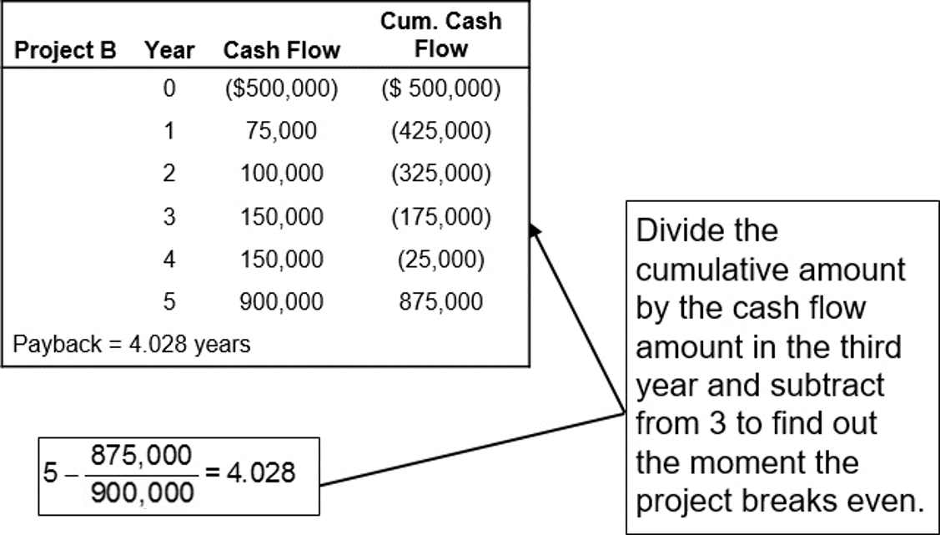
Payback Period Example (3 of 3)
Table 3.6 [continued]

Slide 18
Net Present Value
Projects the change in the firm’s value if a project is undertaken.
Where
F_{t} = net cash flow for period t
r = required rate of return
I = initial cash investment
p_{t} = inflation rate during period t
Higher N P V values are better!

Slide 19
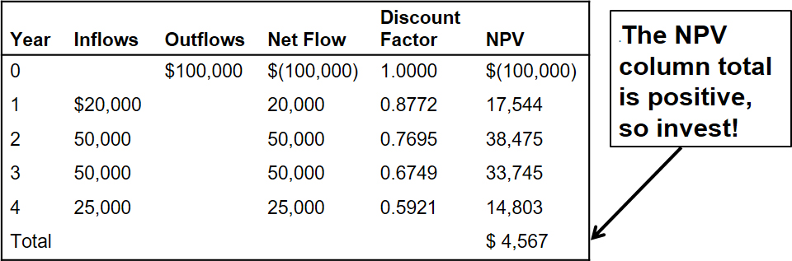
Net Present Value Example
Table 3.8 Discounted Cash Flows and N P V (I)

Slide 20
Table 3.9 Discounted Payback Method
Year | Project Cash Flow* Discounted | Undiscounted
1 | $8,900 | $10,000
2 | 7,900 | 10,000
3 | 7,000 | 10,000
4 | 6,200 | 10,000
5 | 5,500 | 10,000
Payback Period | 4 Years | 3 Years
*Cash flows rounded to the nearest $100.
Discount sum of cash flows by the company’s required rate of return to get a more accurate payback period.

Slide 21
Internal Rate of Return
A project must meet a minimum rate of return before it is worthy of consideration.
Higher I R R values are better!
where
A C F _{t} = annual after tax cash flow for time period t
I O = initial cash outlay
n = project’s expected life
I R R = the project’s internal rate of return

Slide 22
Internal Rate of Return Example
This table has been calculated using a discount rate of 15%.
Year | Discount Factor Inflows | Discount Factor at 15% | Discount Factor N P V
1 | $2,500 | .870 | $2,175
2 | 2,000 | .756 | 1,512
3 | 2,000 | .658 | 1,316
Present value of inflows | Blank | Blank | 5,003
Cash investment | Blank | Blank | 5,000
Difference | Blank | Blank | $ 3
The project does meet our 15% requirement and should be considered further.

Slide 23
Project Portfolio Management
The systematic process of selecting, supporting, and managing the firm’s collection of projects.
Portfolio management objectives and initiatives require:
decision making
prioritization
review
realignment
reprioritization of a firm’s projects

Slide 24
The Portfolio Selection Process
The portfolio selection process is an integrated framework of interrelated steps and activities.
Preprocess Phase
Methodology of selection and strategy
Process Phase
Prescreening, individual project analysis, screening, portfolio selection, and portfolio adjustment
Postprocess Phase
Project development, project evaluation, and portfolio completion

Slide 25
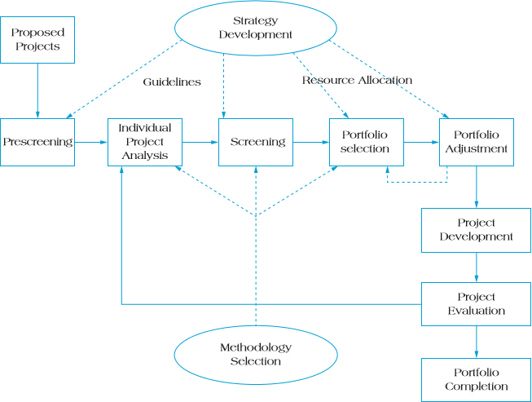
Figure 3.8 Project Portfolio Selection Process

Slide 26
Developing a Proactive Portfolio
The project portfolio matrix classifies projects into four types according to commercial potential and technical feasibility:
Bread and butter
Pearls
Oysters
White elephant

Slide 27
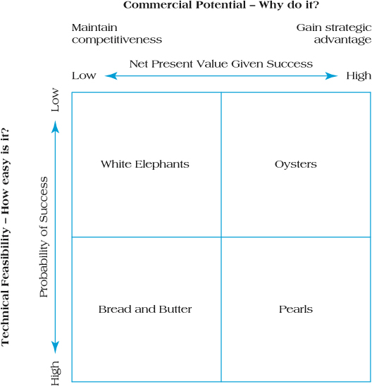
Figure 3.9 Project Portfolio Matrix

Slide 28
Keys to Successful Project Portfolio Management
Flexible structure and freedom of communication
Low-cost environmental scanning
Time-paced transition

Slide 29
Problems in Implementing Portfolio Management
Conservative technical communities
Out-of-sync projects and portfolios
Unpromising projects
Scarce resources

Slide 30
Summary
Explain six criteria for a useful project selection/screening model.
Understand how to employ a variety of screening and selection models to select projects.
Learn how to use financial concepts, such as the efficient frontier and risk/return models.
Identify the elements in the project portfolio selection process and discuss how they work in a logical sequence to maximize a portfolio.

Slide 31

Copyright

